Slide 1

YESHWANTRAO CHAVAN COLLEGE OF ENGINEERING
Department of Electrical Engineering Introductory Project Seminar
on
presentation by (1) Ayush Jha (2) Himanshu Kamble (3) Sarthak Sakhare
(4) Ninad Raut (5) Ninad Ragit (6) Ayush Nagpure
(VII SEM B.E. Electrical Engineering)
(2021-22) under the guidance of Prof. R.M. Gimonkar
DESIGN AND DEVLOPMENT OF ARDUINO BASED SMART BATTERY MANAGEMENT SYSTEM

Slide 2
Aim & Objective
General :
A simple Battery Management System is designed and implemented to monitor various parameters of a battery pack and to optimize its use.
Detailed :
The purpose of this project is to analyze the future of batteries, the lithium ion cells and to exercise a BMS to better understand it’s capabilities and possible cases for errors. Lithium ion batteries if overcharged or over discharge can result in high temperature, venting of gases, fire, reduction of life cycle or even explosions in some cases. Therefore BMS i.e., a battery management system is devised and mandatory to be used with lithium-ion battery packs.

Slide 3
Study Area :
1.Power electronics :
Power electronics is the application of solid-state electronics to the control and conversion of electric power. In contrast to electronic systems concerned with transmission and processing of signals and data, in power electronics substantial amounts of electrical energy are processed.
2.Arduino UNO :
The Arduino Uno is an open-source microcontroller board based on the Microchip ATmega328P microcontroller. The board is equipped with sets of digital and analog input/output (I/O) pins that may be interfaced to various expansion boards and other circuits. The board has 14 digital I/O pins (six capable of PWM output), 6 analog I/O pins, and is programmable with the Arduino IDE (Integrated Development Environment), via a type B USB cable.
3.Lithium-ion Cell :
lithium-ion (Li-ion) battery is an advanced battery technology that uses lithium ions as a key component of its electrochemistry.
The anode and cathode are capable of storing lithium ions. Energy is stored and released as lithium ions travel between these electrodes through the electrolyte. The charger passes current to the battery. Lithium ions move from the cathode to the anode through the electrolyte.

Slide 4
Plan of project work :
1.Identifying problems and limitations of Li-ion battery packs.
Li-ion battery packs are fragile and a protection circuit is required to ensure safety. They need to be protected against over-voltage, over-current, over-discharge and also individual cell balancing is required.
2.Input of various parameters from a battery.
Various methods can be used in order to measure different parameters associated with a battery pack like – battery voltage, state of charge, state of health, cell temperature, etc.
3.Calculation and estimation of battery parameters.
Parameters like state of charge, state of health ,time required to charging need to be calculated by a microprocessor(Arduino UNO in this case)
4.Selection of Components.
Transistors, Zener diodes, oled display, thermistor as temperature sensor, Arduino UNO of appropriate value are to be selected.
5.Designing and implementation of circuit board of BMS.
A circuit board is to be designed which can form a link between the Arduino UNO and the battery pack so that Arduino can make various calculations and display it on the oled display used and the circuit board also needs to perform various actions like cell balancing over voltage and current protection.

Slide 5
Methodology
General Idea:
Usually the nominal voltage of li-on cell is 3.8v and 4.2V when fully charged. So as soon as the cell will reach 4.2V, the charging should stop. When we have only one cell we should only care about maximum voltage and the current limit to protect the cell.
But what if we have more than one cell in the circuit, Lets say 3 cells. The circuit also need to balance the value of each individual cell. If we have 3 cells in series then the total voltage will be 3 times 4.2V i.e. a total voltage of 12.6V, when a constant voltage of 12.6V or more is applied to the system then battery pack will start charging. The main problem here is that not every cell will have same internal structure so one will charge faster and other a bit slower. In this scenario the cells which are charging faster will get over voltage and will get damaged.

Slide 6
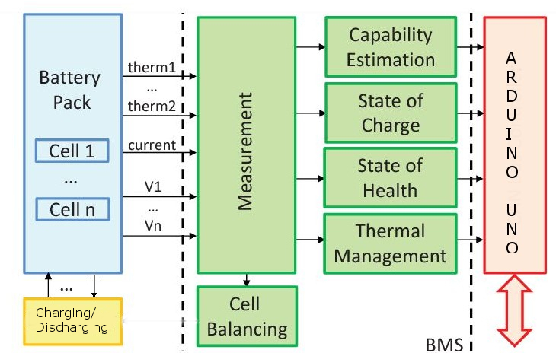
Block Diagram:

Slide 7
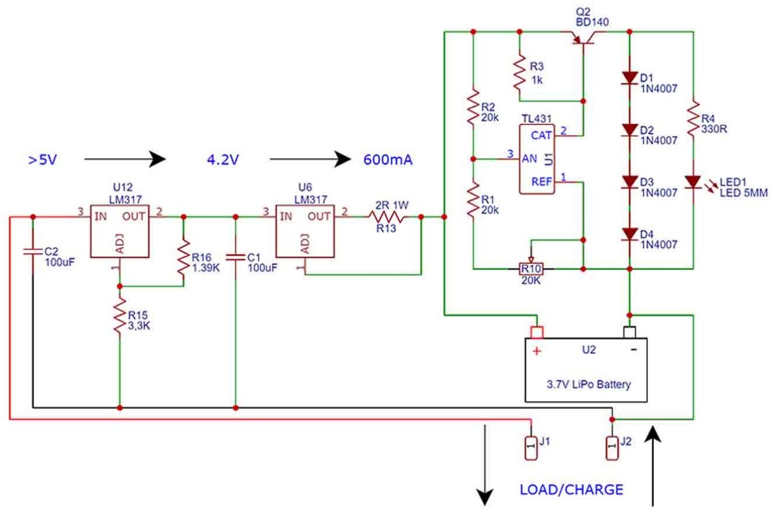
1S Charger Circuit Diagram :

Slide 8
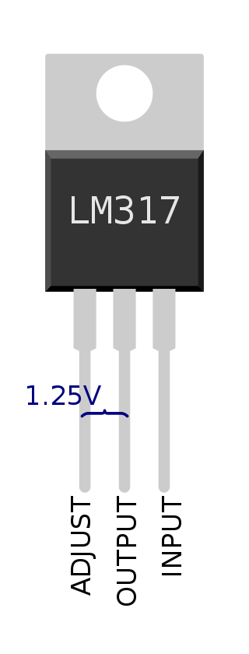
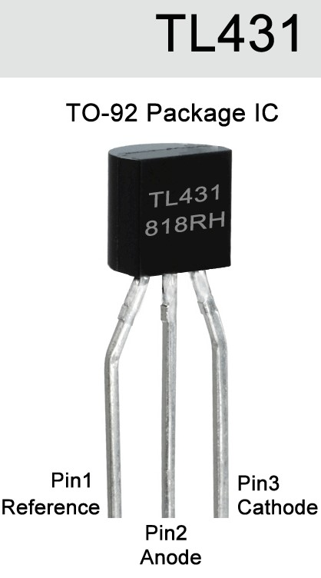
Components Used:
1.LM317:
The LM317 device is an adjustable three-terminal positive-voltage regulator capable of supplying more than 1.5 A over an output-voltage range of 1.25 V to 37 V.
LM317 in Voltage regulator mode -
The LM317 has three pins: Input, Output, and Adjustment. How the adjustment pin is connected determines the output voltage as follows.
If the adjustment pin is connected to ground the output pin delivers a regulated voltage of 1.25 V at currents up to the maximum. Higher regulated voltages are obtained by connecting the adjustment pin to a resistive voltage divider between the output and ground. Then
Vout = Vref (1 + RL/RH)
Vref is the difference in voltage between the OUT pin and the ADJ pin. Vref is typically 1.25 V during normal operation.
LM317 in Current regulator mode –
The device can be configured to regulate the current to a load, rather than the voltage, by replacing the low-side resistor of the divider with the load itself. The output current is that resulting from dropping the reference voltage across the resistor. Ideally, this is:
Iout = Vref/RH
2.TL431:
The TL431 is a three-terminal adjustable precision shunt voltage regulator integrated circuit. With the use of an external voltage divider, a TL431 can regulate voltages ranging from 2.5 to 36 V, at currents up 100 mA. The circuit can control power transistors directly; combinations of the TL431 with power MOS transistors are used in high efficiency, very low dropout linear regulators.

Slide 9
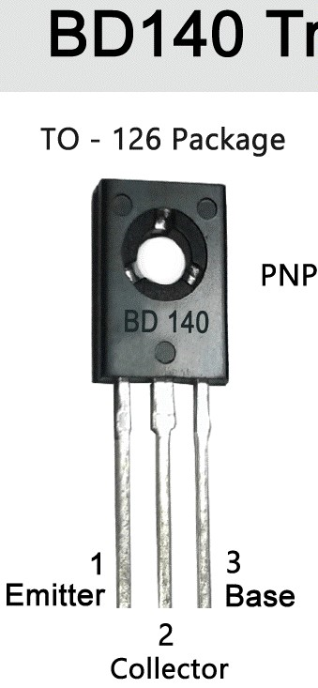
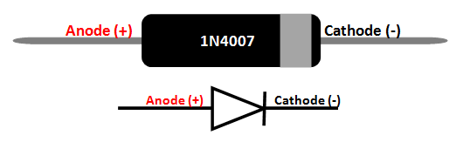
3.BD140 PNP Transistor:
BD140 is a famous PNP type transistor, it is used in many electronics circuits, this transistor can handle current up to 1.5A or 1500mA, due to which it can be used to drive loads up to 1.5A in electronic circuits, for example high power LEDs, relays, motors and more, with these features it has lots of other features like its high collector emitter and collector base voltage that is 80 volts, make it an ideal transistor to use in circuits using 80 volts DC or below 80 volts.
Features and Technical Specifications-
Package Type: TO-126
Transistor Type: PNP
Max Collector Current(IC): -1.5A
Max Collector-Emitter Voltage (VCE): –80V
Max Collector-Base Voltage (VCB): –80V
Max Emitter-Base Voltage (VEBO): –5V
Max Collector Dissipation (Pc): 12.5 Watt
4.1N4007 Diode:
1N4007 Diode, the maximum current carrying capacity is 1A it withstand peaks up to 30A. Hence we can use this in circuits that are designed for less than 1A. The reverse current is 5uA which is negligible. The power dissipation of this diode is 3W.

Slide 10

Working of 1S Charger:
We have a PNP transistor connected in series with 4 diodes that will simulate a load. At the base of the transistor, we have a ZENNER reference diode (TL431) which will get open at a certain voltage value and by that connects ground to the transistors base and when the transistor is active, we bypass the battery and waste the power on the diodes instead. This ZENNER diode is the TL431 and it has a reference pin, so by adjusting the potentiometer we can set this reference to be at 4.2V, that’s how we select when the charging process will stop.

Slide 11
Work planned for next seminar:
1.Implementation of multiple cells in BMS model.
2.Using thermistor as a temperature sensor to monitor battery temperature.
3.Using Arduino UNO to calculate various parameter like state of charge, battery health, time required for charging.
4.Displaying various parameters of the battery on the mini oled display.
5.Addition of Bluetooth module with the Arduino to send battery information on nearby smart devices.

Slide 12
Conclusion:
BMS is a essential element for the battery to perform surveillance, control,
balance and diagnostic in order to not just keep the cells secure state but to
collect data that have the possibility evaluate how the battery behave with time.
We successfully designed a circuit board to charge a single lithium ion cell with over current, over voltage and over charging protection.

Slide 13
References:
[1] Authors: A. Hariprasad , I. Priyanka , R. Sandeep , V. Ravi, O. Shekar Paper ID : IJERTV9IS050458 Volume & Issue : Volume 09, Issue 05 (May 2020) Published (First Online): 23-05-2020 ISSN (Online) : 2278-0181 Publisher Name : IJERT
[2] Authors: Nathan Scharich Brandon Schniter Anthony Herbert Md. Shafiul Islam June 2017 DOI:10.1109/TEMSCON.2017.7998405 Conference: 2017 IEEE Technology & Engineering Management Conference (TEMSCON)
[3] Barsukov, Yevgen; Qian, Jinrong (May 2013). Battery Power Management for Portable Devices. ISBN 9781608074914.

Slide 14
Thankyou

